Slide 1
Chapter 5: DATA EXPLORATION AND PROFILING

Slide 2
Contents
What is data profiling
Profiling Data in Knowledge Studio – Dataset Viewer
Overview Report
Dataset Chart
Data Viewer
Filter
Segment Viewer
Cross Tabs
Characteristic Analysis
Correlations
Multicollinearity Analysis
Schema
Outlier Detector

Slide 3
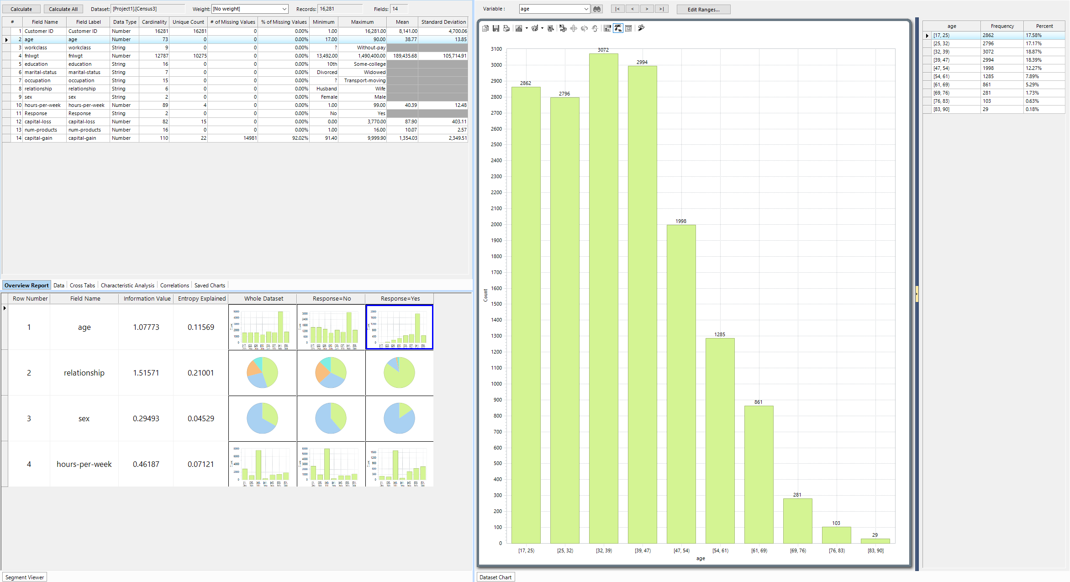
What is Data Profiling
Data profiling is about getting to know your data
ask the right questions and make the right decisions
Things to look for and understand:
Distributions
Correlated variables
Extent of missing values
Outliers
Potentially predictive variables
Anomalies / points of interest
Notes:
Data exploration or data profiling is an essential and integral part of Data Mining. It’s a preliminary step to further modelling or simply to attempt to better understand data.
Exploration of data involves examining the characteristics and distributions of the dataset fields to identify potential issues and ultimately important factors and patterns that distinguish the data.
These aspects are not only used to explore a dataset but also as a preliminary set of tools to identify potentially good predictors of an outcome, target, or Dependent Variable, prior to modelling.

Slide 4
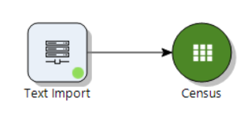
Importing Data
Many data profiling features in Knowledge Studio can be accessed from dataset object
All dataset objects have data profiling features
Features can be accessed by double-clicking on the object from the Workflow canvas

Slide 5
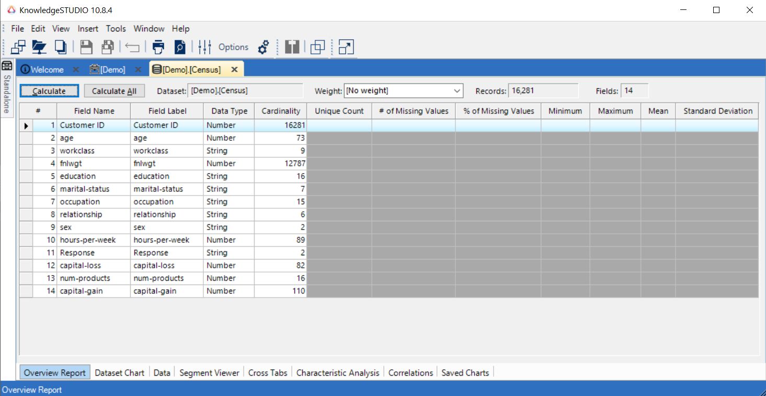
Profiling Data with Knowledge Studio- Dataset
Starting point:
Dataset Viewer
Opens on Overview Report, but note the tabs
Demo
Dataset Profiling Tabs
Notes:
The dataset used in all demonstrations from this point onwards is an excel file; Census.xlsx. This file is
based on a set of 16,281 records. The Data Mining steps and modelling in following chapters are tuned to
marketing operations.
… -> <only talk about the overview report in software>
Prior to modeling investigate dataset for good predictors
Variables to remove
Large % missing values
Constant fields (cardinality = 1)
Key columns (e.g. ID, phone number)
Variables used to derive the DV (that have large direct correlation with DV)

Slide 6
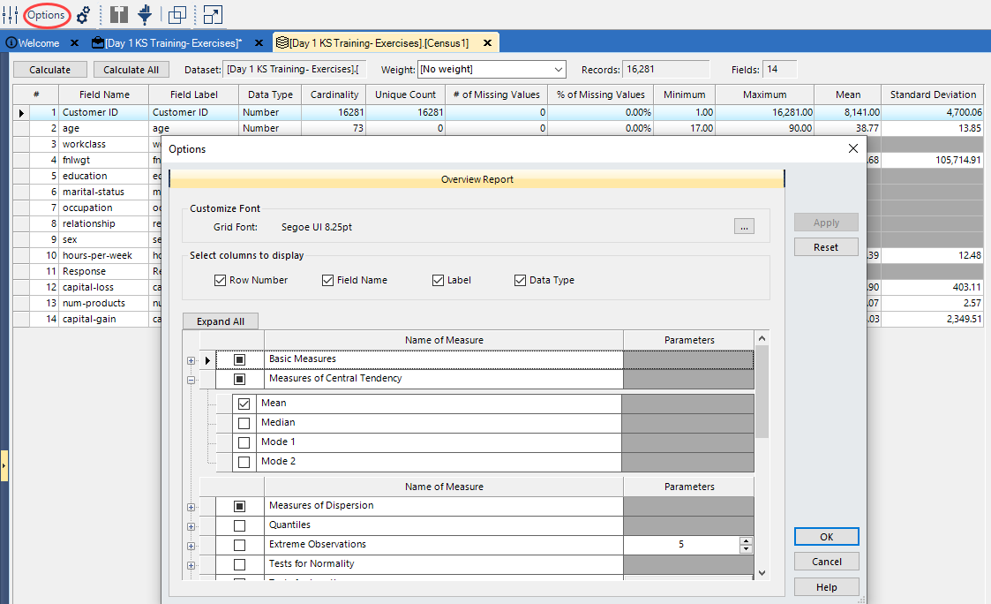
Overview Report
Dataset viewer opens on this tab
Provides summary statistics of the data
Many additional univariate statistics available in Options
Can also use Preferences to set default options

Slide 7
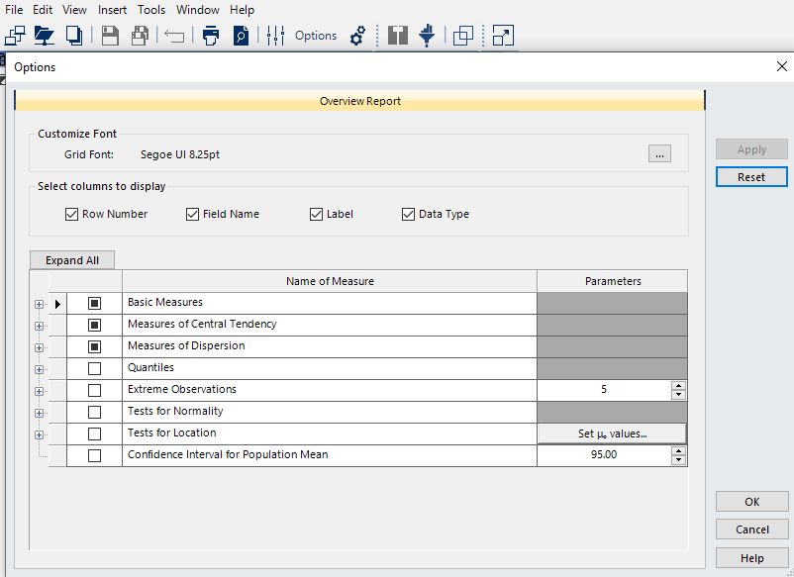
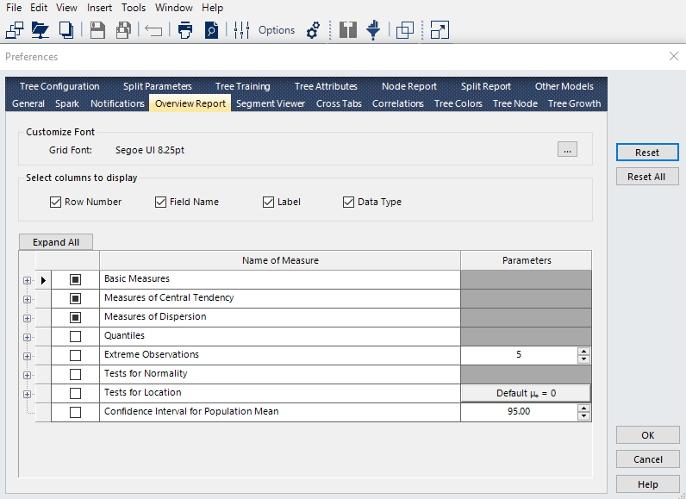
Overview Report – Additional Statistics
Additional univariate statistics available in Options
Can also use Preferences from Tools to set default options

Slide 8
Default Univariate Statistics in Overview Report
Cardinality
How many different values of that variable there are
Unique Count
How many different values appear in the dataset exactly once
Not to be confused with cardinality
Number of Missing Values, Percent of Missing Values
This is always important to check – so important it got 2 different columns
Min, Max
Mean, Standard Deviation
Notes:
What are some other common univariate statistics you might want to see?

Slide 9
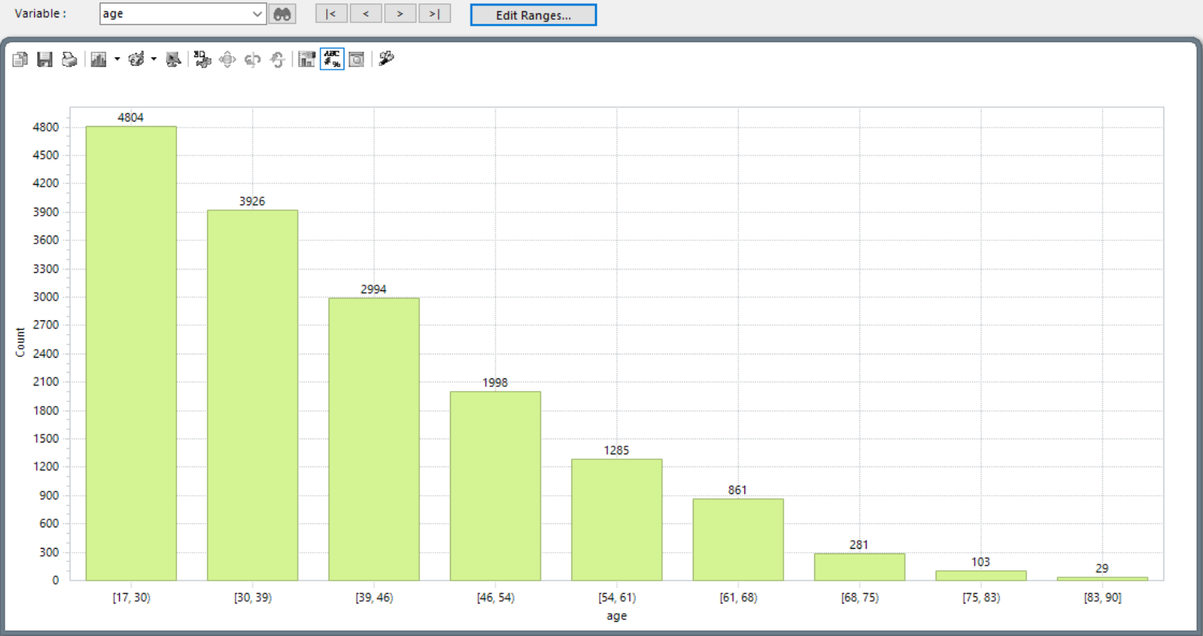
Dataset Chart
Graphically displays the distribution
Continuous variables displayed as a histogram by default
Discrete variables displayed as a pie chart by default
Chart is customizable
Variable ranges can be edited with the Edit Range button
Chart type can be changed
Other visual changes also available
Demo

Slide 10
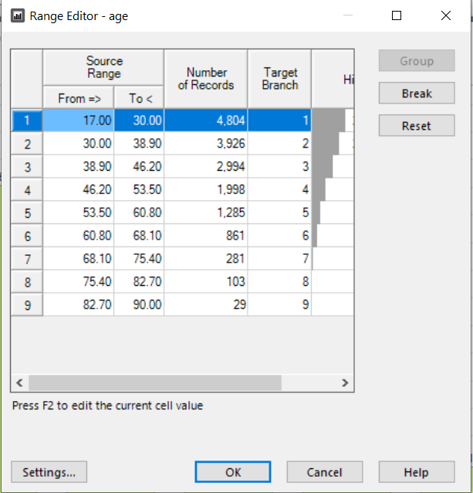
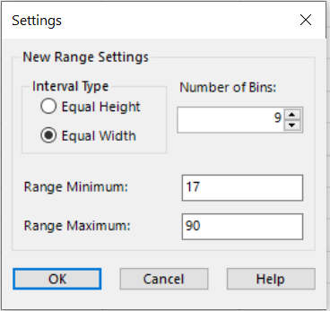
Dataset Chart
Can change the binning manually
Notice the helpful (simple) histogram
Defaults are set in the Settings dialog
Helpful equal height or width options

Slide 11
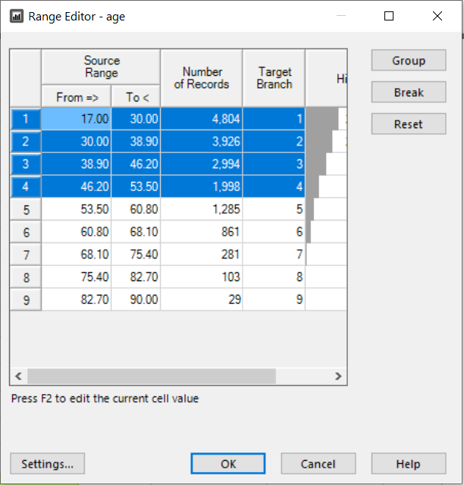
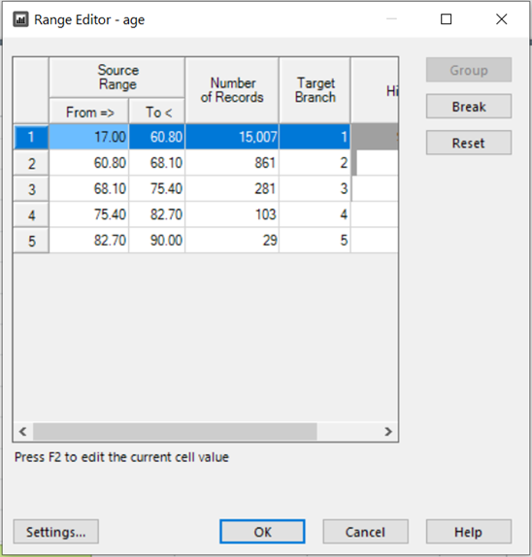
Data Profiling – Dataset Chart - Binning
Binning Variables – to group, highlight the contiguous ranges and click the group button
Bins 1 to 5 have been grouped into one bin
To create new ranges, highlight the range and click the Break button and enter the break point

Slide 12
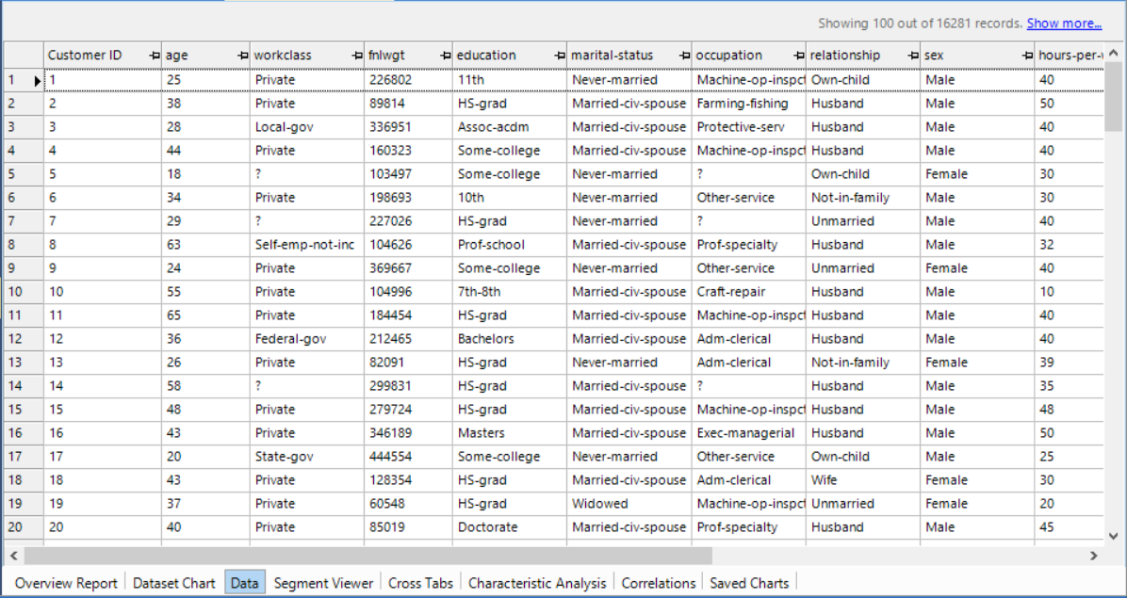
Data Viewer
Displays all the fields and their values for all the records in the dataset
This looks like an excel spreadsheet, but data CANNOT be edited
Can sort by column, change order, hide columns, filter

Slide 13
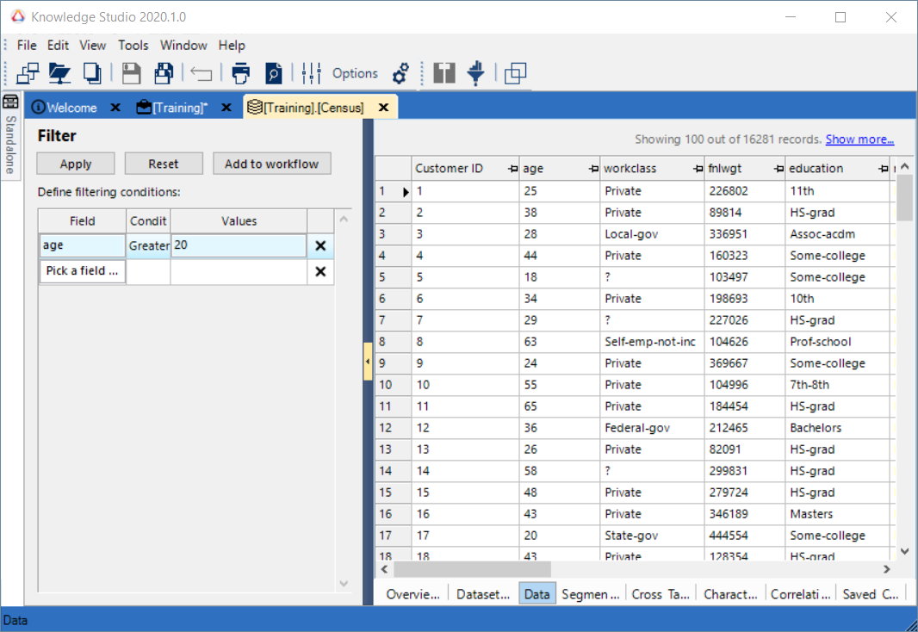
Filter
Interactive filtering within the dataset views
A dockable filter panel opens in dataset viewer (tabs)
Define the filtering conditions by adding them in the grid of the Filter panel, one row per field
"AND" is the implied operator for combining the conditions
Switch between the filtered and unfiltered views with a single click of Filter icon
Option to generate filtered dataset on workflow
Demo
* Available in version 10.9 or after
Notes:
Perform interactive filtering within the dataset views - without going back to the workflow and creating a new dataset. A dockable filter panel opens in all dataset views (tabs) to serves this purpose.

Slide 14
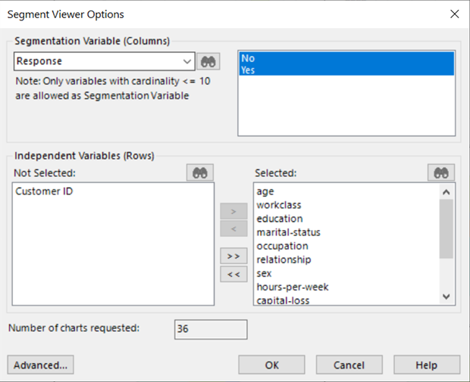
Segment Viewer
The segment viewer is useful for finding potentially predictive variables
Looking for variables with different distributions across DV categories
Options dialog is used to choose:
The segmentation variable
Must be categorical variable
Must have low cardinality
Variables to compare with the segmentation variable
Demo
Notes:
Segment Viewer is a distribution plot for all variables that I picked in the segment viewer against any target variable. In this case Response variable as the Target Variable.

Slide 15
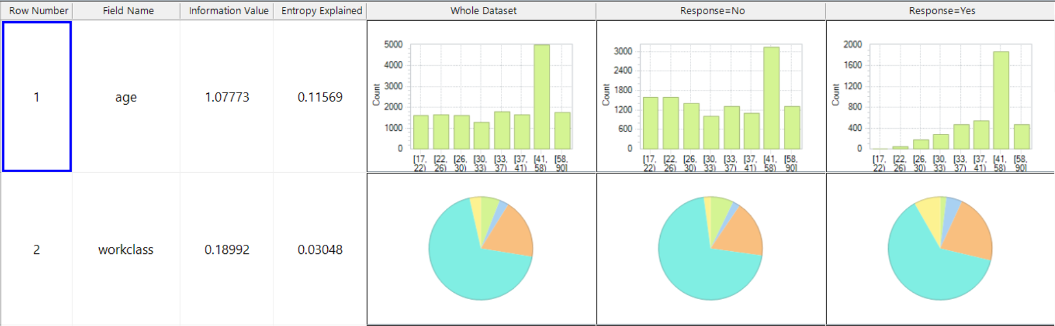
Segment Viewer
Displays distributions of the IVs under each category of the segmentation variable
Can be used to determine if the distributions of the other variables (usually IVs) vary across the segmented variable
Sort using Information Value or Entropy Explained
Notes:
I get to see what distribution looks like for the whole dataset and I can see all the variables that are available.
Second column gives me distribution for all records where the Response was No, and the third column gives me for the Yes Response.
All these are dynamically generated depending on what target variable I picked. So, we can see some different distributions here right off top just visually looking at age, you see that Yes responders tend to be older.
We’ve included both the Information Value and Entropy Variance to see which variables are most related to the target variable. If you have large number of variables, these empirical methods give you ability to short-cut the process. You see this information Value and Entropy Variance, If I click on any of these, I can sort the variables in descending or ascending order. So, in this case relationship, marital status and age end up being highest ranking variables and potentially good predictors.
(It’s actually one of the algorithms we use for decision trees)

Slide 16
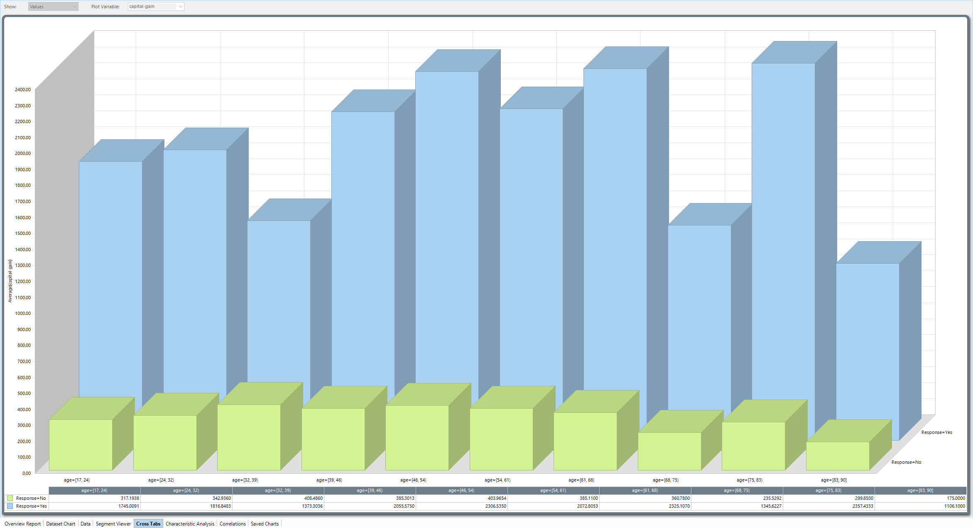
Cross Tabs
View relationships between variables
Variables must be categorical for the bar chart which is the default
Numeric variables will be allowed, but they will be binned automatically
Visualize multiple segmentations at the same time
Can plot counts or the aggregation of an additional numeric variable
Also here: surface chart or scatter plot for numeric variables

Slide 17
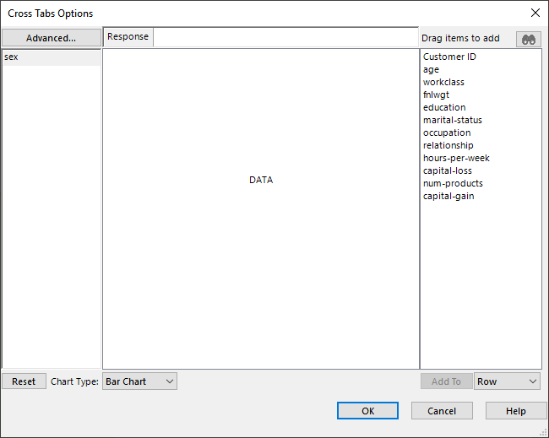
Cross Tabs – Options
Drag and drop variables into rows and columns
Can also drag aggregation variable (to the middle)
Chart Type option at the bottom
Can edit the binning using the Advanced button
Demo

Slide 18
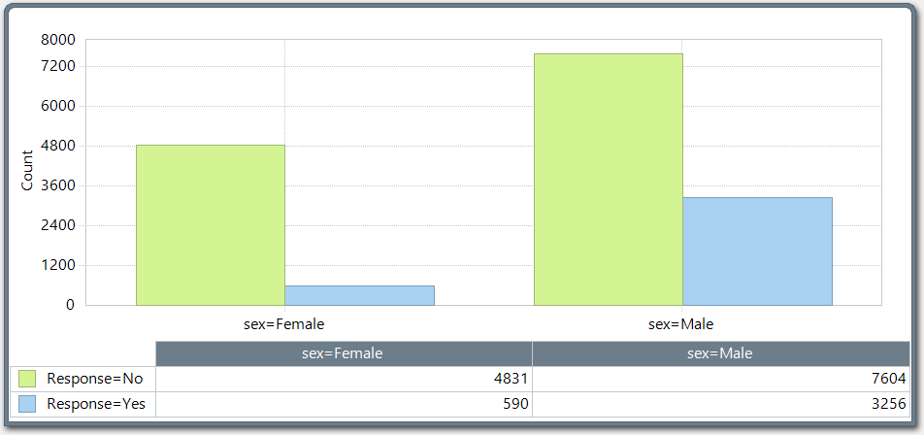
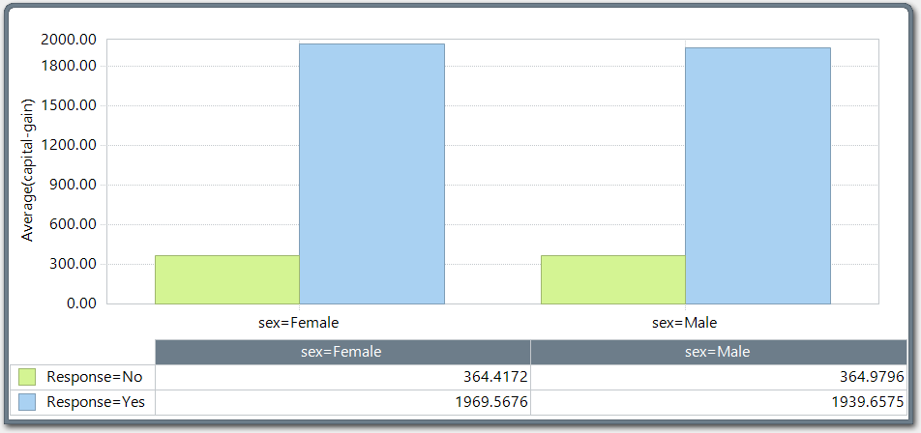
Cross Tabs Charts
Example without Aggregate Variable: Example with Aggregate Variable:
Counts are displayed on the y-axis Aggregate of chosen numeric variable on the y-axis

Slide 19
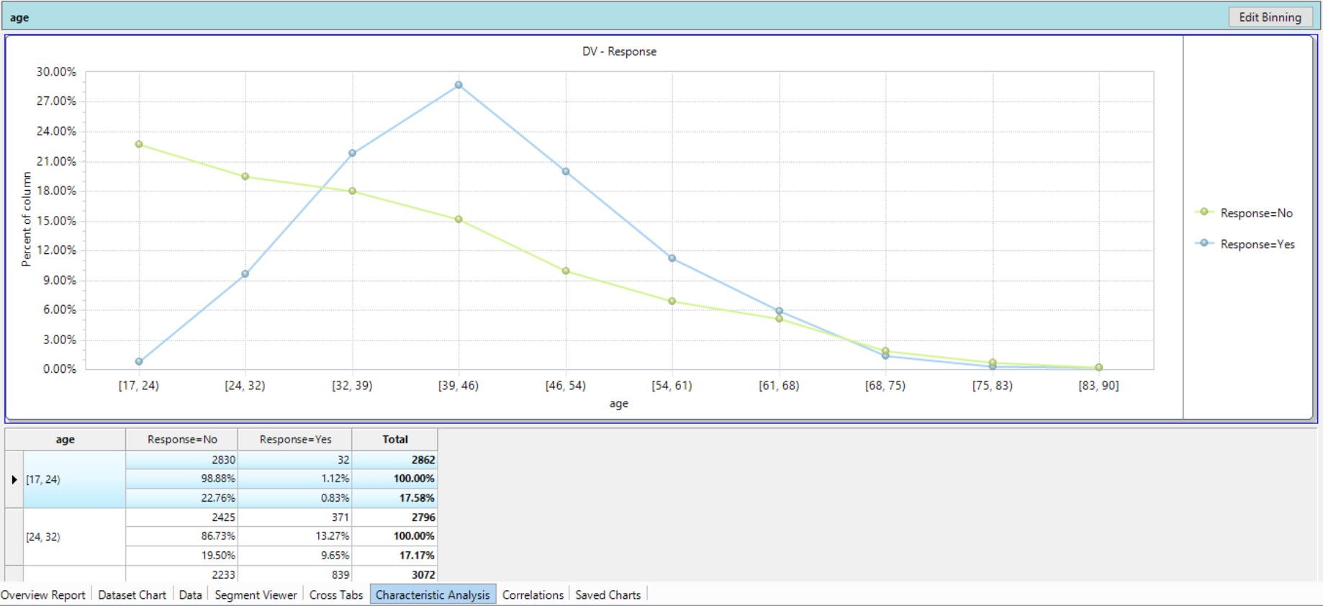
Characteristics Analysis
Special cross tabulation plots and charts for two variables at a time
View percentage of rows, percentage of columns, or raw numbers of one variable in each category of the Characteristic Analysis Variable
Can view multiple plots (stacked)
Can edit binning
Demo

Slide 20
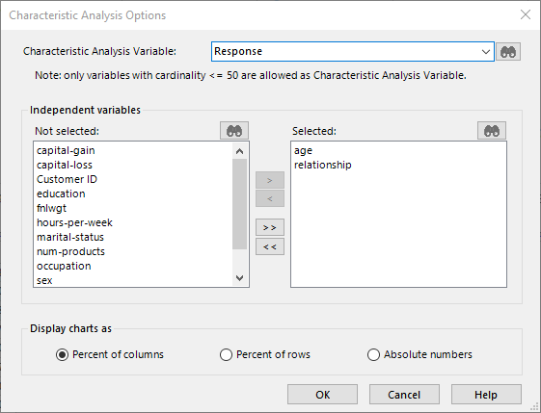
Characteristic Analysis Options
Choose Characteristic Analysis Variable
Must be categorical variable
Limit to cardinality <=50
Choose independent Variables to plot
Display options
Edit binning once the charts have been created
Demo

Slide 21
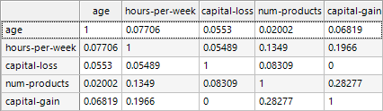
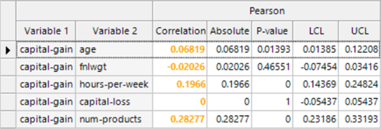
Correlations
A measure of the relationship between numeric variables
All variables must be numeric
Closer to ± 1 means the variables have a stronger relationship
Closer to 0 means the variables have a weaker relationship
Results can be displayed in the form of correlation matrix, as pairs, or in a chart
Can also highlight cells based on their value
Useful if you have many variables, in which case the matrix gets quite large and hard to understand
Demo

Slide 22
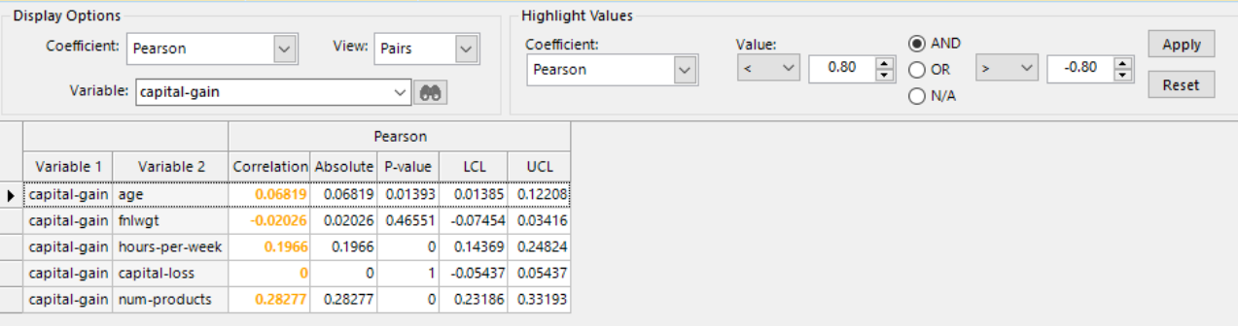
Data Profiling – Correlations
Correlation Diagnostics
Option allows for enhanced variable selection:

Slide 23
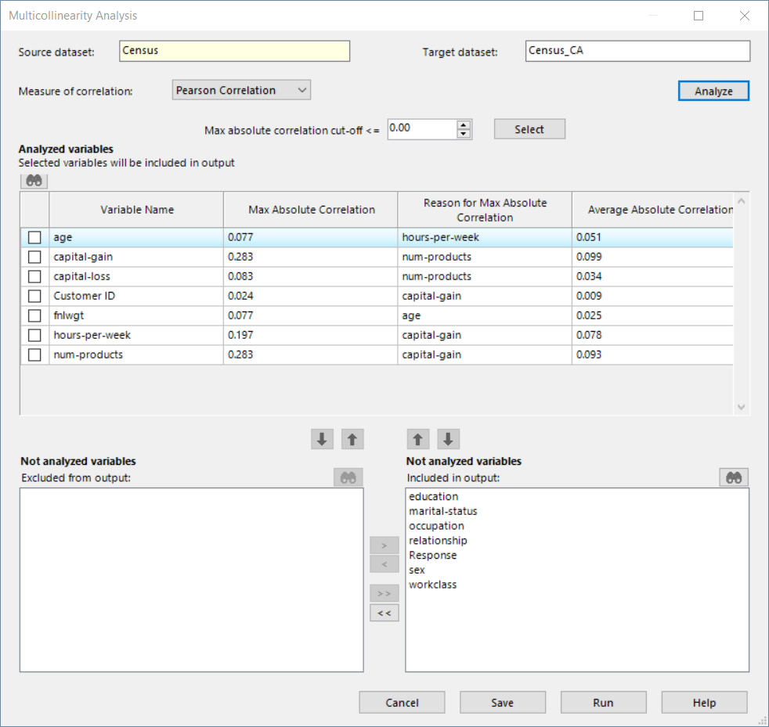
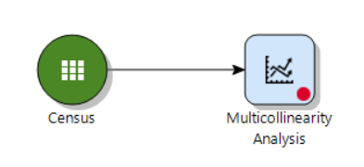
Multicollinearity Analysis
Multicollinearity Analysis node can be used to remove highly correlated numeric variables from a dataset
Threshold for removal is set by the user
Correlation measures include Pearson and Spearman
Max correlation is shown for all analyzed variables when the Analyze button is clicked

Slide 24
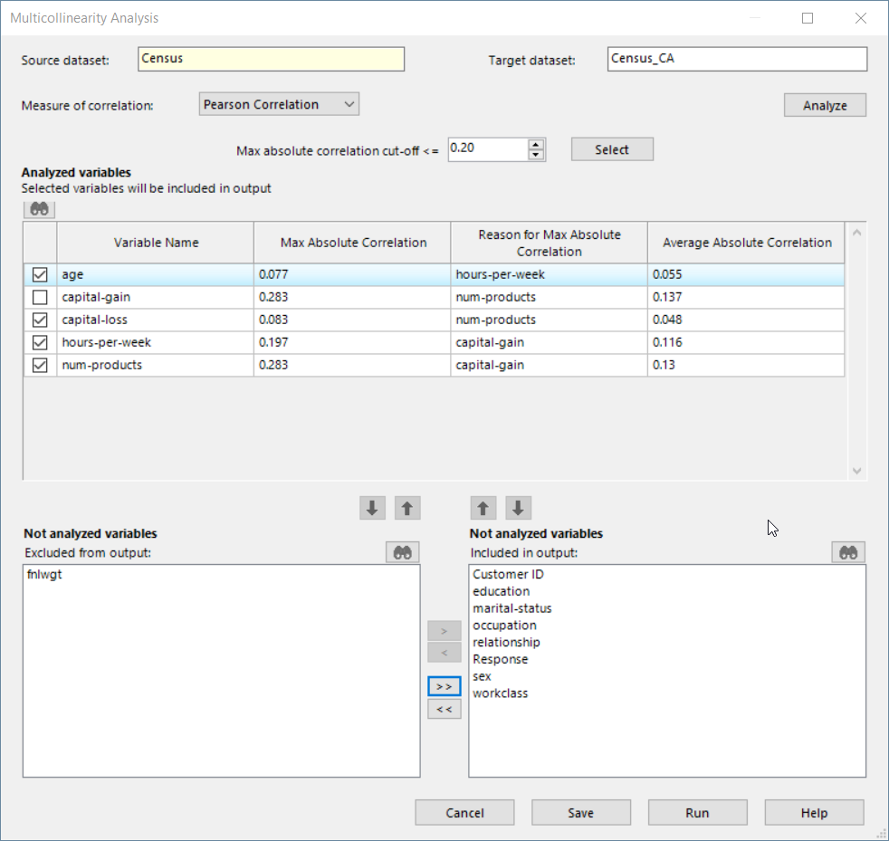
Variable Selection with the Multicollinearity Analysis Node
Example variable selection shown here:
Max Correlation threshold is set to <= 0.20
Select button will check only variables that fulfill the threshold requirements
Capital-gain not checked because it exceeds max correlation threshold of 0.2, and will be excluded from the output dataset
Fnlwgt will not be included in the output
All not analyzed variables in this box will be included in the output. These variables were excluded from the analysis because of their categorical nature
Demo
1
2
3
4
5
Notes:
Note: Some variables with Max absolute correlation exceeding the cut-off will also get selected according to the following rule: Suppose Variable V1 has Max Absolute Correlation greater than the cut-off, and the corresponding highly correlated variable is V2. Then the value of Average Absolute Correlation will be compared for V1 and V2, and the one with lower Average Absolute Correlation will get selected, while the other will get excluded.

Slide 25
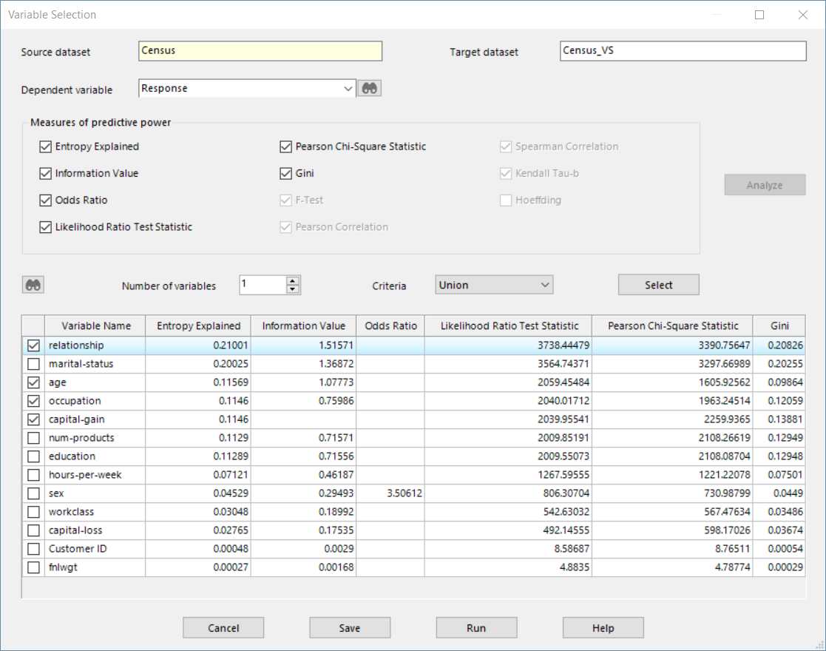
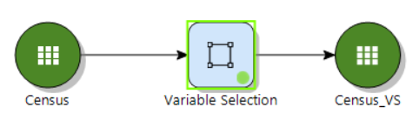
Variable Selection
Use to investigate measures of predictive power (MPP)
Set DV, choose measures, click on analyze
Can manually or automatically select the top variables by MPP
Union or Intersection options
This node is useful for exploration, but can also create a new (simplified/filtered) dataset
Demo
Notes:
To asses predictive power of variables relative to a target variable

Slide 26
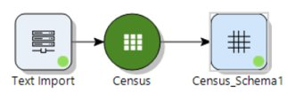
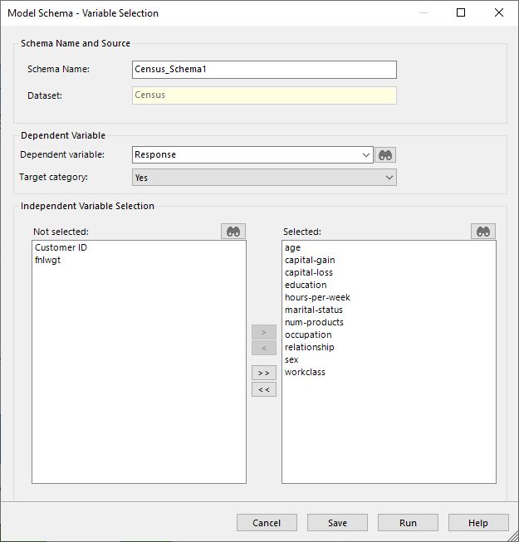
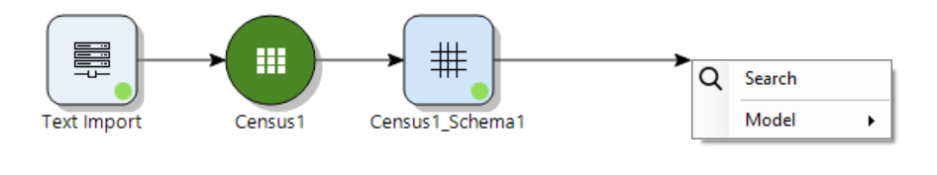
Schema
Can be useful if you’re making many models with the same IV/DV choices by saving selected settings
Example shows Response selected as DV, and all other variables selected, excluding Customer ID and fnlwgt, as IVs
Can be used upstream of model nodes by linking modeling node directly to Schema node
Demo

Slide 27
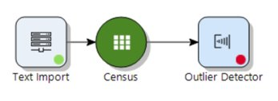
Outlier Detection
Performs automatic detection of outliers in a dataset. An outlier record is a record with an extreme value in at least one variable
For data quality control, anomaly / fraud detection, and data manipulation to prevent a disproportionate effect of outliers on modeling

Slide 28
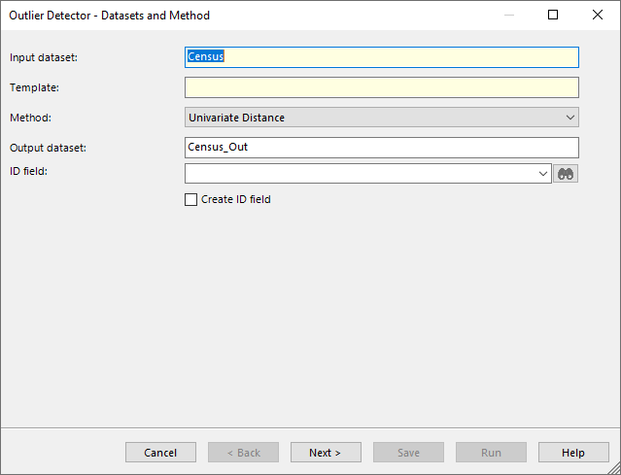
Outlier Detection Node Settings
Outlier Detection node creates a copy of the input data with outlier records flagged​
Outlier records can be filtered out of the data in downstream process
4 methods available for flagging outliers:​
Univariate Distance​
Mahalanobis Distance​
Tree​
Clustering​
Each method changes required user input for defining outlier records​
Notes:
Trainer notes on methods (from Help):​
Univariate Distance​
For each variable tested for outliers (focal variables), the user must first select the desired measure of univariate distance. A record will be flagged as an outlier if the value in any of the selected focal variables is greater than X distance units away from the centre of the distribution, where the cutoff value, X, is specified by the user. This method is selected by default. See the details below.​
Mahalanobis Distance​
A record will be flagged as an outlier if it is greater than X multivariate Mahalanobis distance units away from the centroid of the focal variables, where the cutoff value, X, is specified by the user in the next page.​
Tree​
A decision tree is automatically grown using the parameters specified by the user in the next wizard page. Then the method finds all terminal nodes with fewer than N records and flags all records in all such nodes as outliers. The number N is specified by the user in the last page of the wizard.​
Clustering​
A Cluster Analysis model is run using the parameters specified by the user in the next wizard page. Then the method finds all records that either belong to clusters with fewer than N records or do not belong to any cluster, and flags all such records as outliers. The number N is specified by the user in the last page of the wizard.​
​

Slide 29
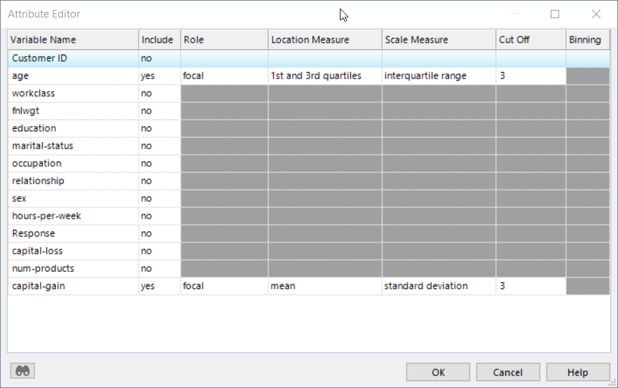
Univariate Distance
Univariate approach (i.e. calculated on individual variables separately) for flagging outliers
Flags outlier records for each selected focal variable, with grouping variables optional
For each focal variable Location Measure determines how the center is calculated
Scale Measure along with Cut Off determine the distance from center that will identify a record as an outlier

Slide 30
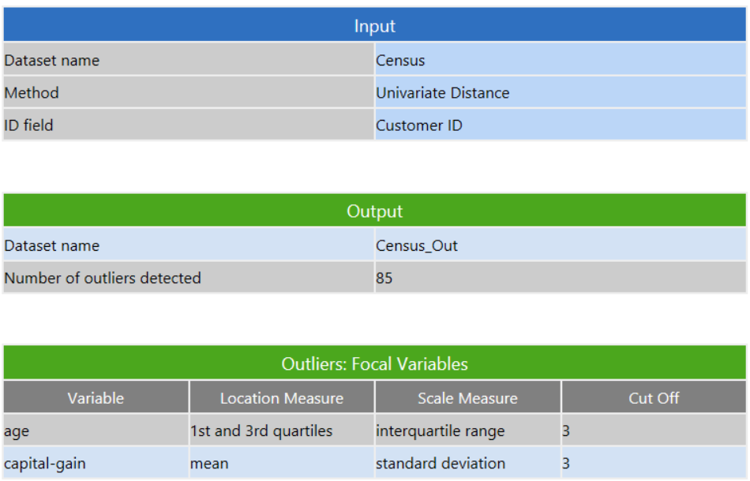
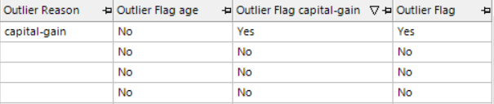
Outlier Detector Report and Data
Report includes
Method used for outlier detection
Number of outlier records
Report contents will vary according to chosen method
Output dataset includes column(s) with an Outlier Flag
Demo

Slide 31
Chapter 5 Exercises (1/3)
If KS is not already open, open it, then import the Census dataset
From the Overview Report tab:
Assess the number of records and variables
Calculate statistics for all variables
Become familiar with the following statistical measures
Cardinality
Extent of missing values
Minimum and Maximum and other statistics
Modify the extent of visible statistics using the Options button
Copy the visible results to any MS Office application (try Excel)
Use the Dataset Charts tab to assess the distributions of the variables
Select variables to view using the dropdown or arrow buttons
Assess the distributions of each variable and modify some Chart Properties
Assess the distribution of the variable; Response. Save the chart

Slide 32
Chapter 5 Exercises (2/3)
4. From the Data tab:
View the data and modify the view to show only categorical variables. (HINT: Options button)
Explore filtering conditions for age and relationship in the drop-down list of interactive filtering
From the Segment Viewer tab:
Choose the variable Response as the Segmentation Variable
Select variables to profile and move to the Selected pane
Fit the charts to the width of the page
Assess whether there are any differences across the categories of the Dependent Variable for
any Independent Variables
Use the Information Value and Entropy Variance columns to aid in identifying variables that
characterize the Dependent Variable

Slide 33
Chapter 5 Exercises 3/3
From the Correlations tab:
Select all continuous variables and choose a coefficient, create the correlation matrix
Choose pairs from the View dropdown and focus the view by selecting one of the variables
Can you re-run and add the variable Response? Why not?
On the Census dataset, use the Multicollinearity Analysis node to create a new dataset with all categorical variables, and only numeric variables that have a max Pearson correlation of <=0.2.
Use the Schema node to create a schema with the variable “Response” as the Dependent variables, and all the other variables selected, excluding Customer ID and fnlwgt.
On the Census dataset, use the Outlier Detector with default settings to identify outliers of in the variable capital-gain. How many outlier records are there? Using the Filter functionality, inspect the records that have been flagged as outliers by filtering out non-outlier records.

